Slide 1

Journalism Story Basics
Media & Leadership Academy
Joe Dennis
justjoedennis@gmail.com

Slide 2
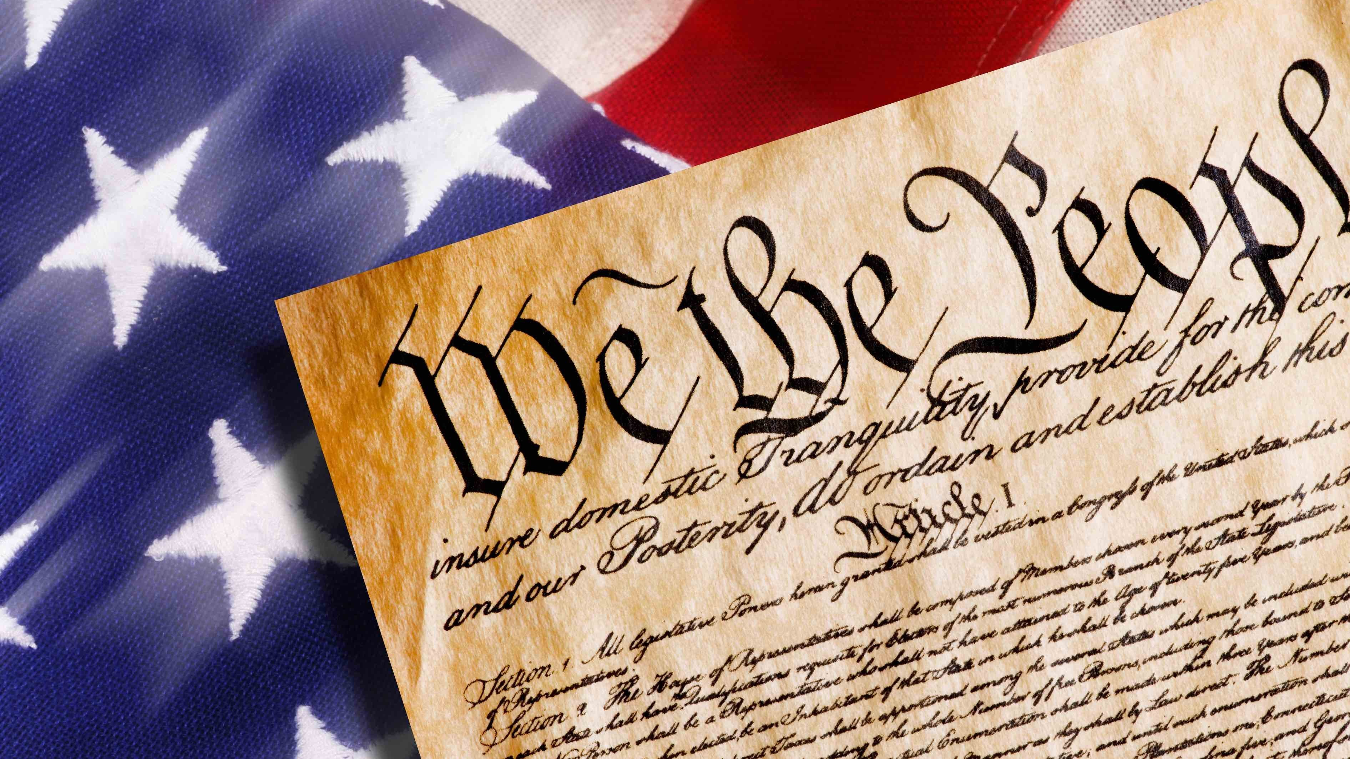
The importance of journalism
Congress shall make no law respecting an establishment of religion, or prohibiting the free exercise thereof; or abridging the freedom of speech, or of the press; or the right of the people peaceably to assemble, and to petition the Government for a redress of grievances.
-1st Amendment to the U.S. Constitution, 1789

Slide 3
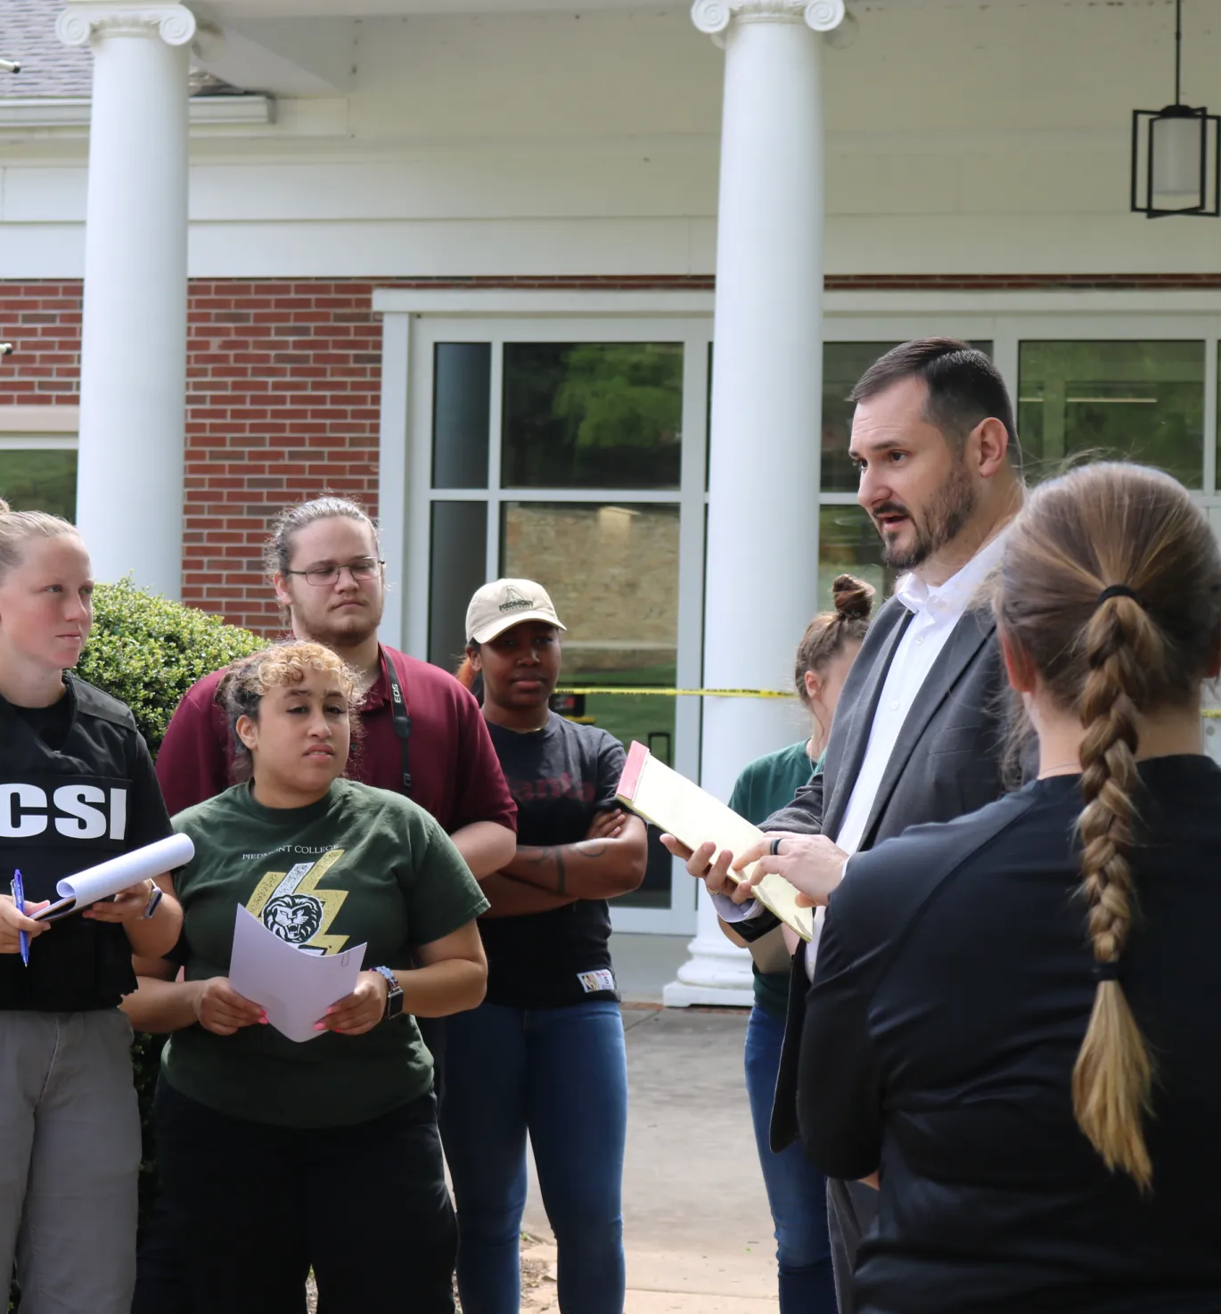
Principles of Journalism
A journalist’s first obligation is to the truth.
Journalists must maintain independence.
A journalist must maintain fairness.
Journalists should be mindful of the impact of their stories to people, showing a concern for humanity.
Journalists should be accountable for their work.
Society of Professional Journalists

Slide 4

Choosing a topic
Identify your interest and knowledge
Consider timeliness and relevance
Consider the feasibility of sources and deadlines
Begin your research

Slide 5
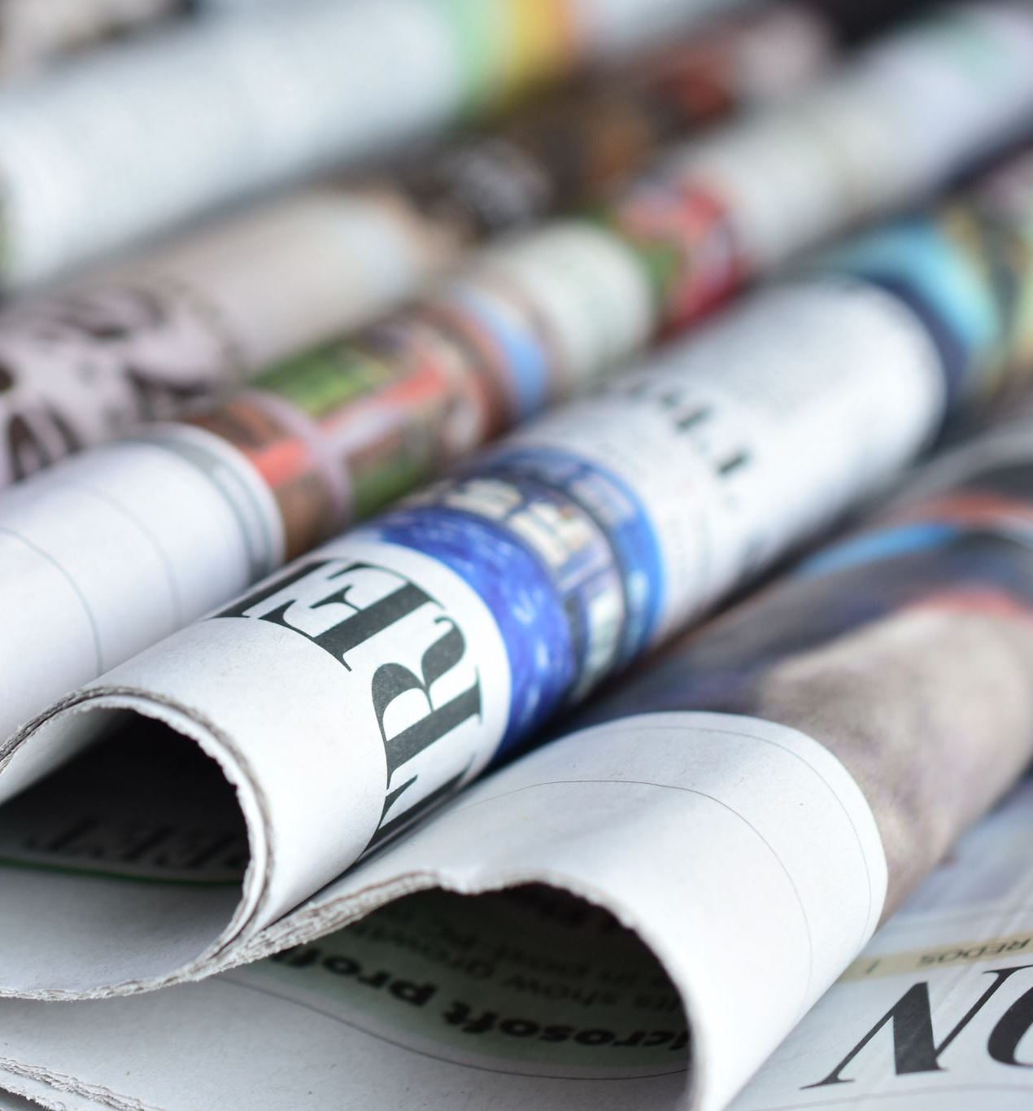
Elements of a journalistic story
Research
Interviews
Quotes / Attribution
Writing
Editing
Publication
Feedback

Slide 6
Assembling the Story
Open with a ‘sexy’ lead focusing on the “who” and “what.”
Follow-up with your best quote from your main source that sums up the story. Strive for a two-sentence quote (with attribution in between).
Use the next 1-3 paragraphs for the NUT GRAF, explaining the rest ”when,” “why,” “where” and “how” of the story.
For the body of the story, let quotes drive the story. Ideally, 2-3 sources.
Close with a quote that best wraps up the story and/or ties back to the lead … or advance the story (where appropriate).
Example 1
Example 2
Example 3

