Slide 1
It’s all about the lead
Dr. Joe Dennis
Piedmont University

Slide 2
Review: Journalistic Writing
The “award-winning” Joe Dennis approach
  Sexy lead
    Focus on the essence of the story, “who did what to whom”
    (A lot more on this coming Friday)
  Lead quote
    The best quote from your primary source
    Reinforces lead
  Nut graf
    The rest of the who, what, when, why, where, how
    Advance the story with a transition
  Quote*
  Explanation/transition*
  *follow quote/transition format until …
  Closing quote or call to action

Slide 3

It’s all in the lead …
The lead sets the precedent for the rest of your story.
Focus on the “who,” “what” and “how.” Not the “when.”
Be sexy ☺
Spend as much time as you need with the lead before writing anything else
Read the lead out loud. Does it flow? Are you stumbling over words? Are you out of breath?

Slide 4
Same story. Different leads.
UGA announces it will no longer play Texas Tech
Bulldawg Illustrated
Georgia athletic director Josh Brooks is taking a stand after a judge’s decision to grant Texas Tech quarterback Brendan Sorsby an injunction to play this season despite being ruled ineligible by the NCAA for gambling.
Athens Banner-Herald
In response to a Lubbock, Texas, judge granting Texas Tech quarterback Brendan Sorsby his injunction against the NCAA, making him eligible to play in the 2026 season as of Monday, Georgia and athletic director Josh Brooks have instructed Bulldog coaches to not schedule the Big 12 school.
24/7 Sports
Georgia wants nothing to do with the Texas Tech athletics program moving forward.

Slide 5
Types of leads
Summary lead
Good for hard news, sports event coverage
Only lead appropriate for sensitive news stories (death, tragedy, etc.)
Usually not sexy

Slide 6

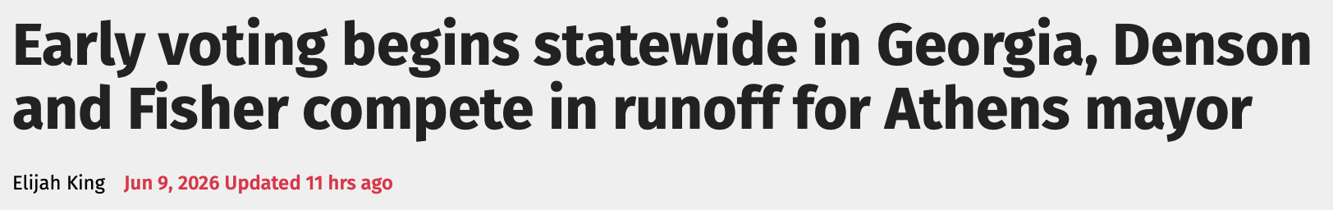
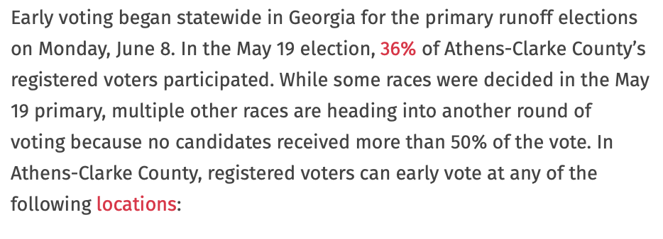
Types of leads
Summary lead

Slide 7
Types of leads
Anecdotal lead
Good for feature stories, profiles
Good for putting a face on more complicated stories
Should be sexy

Slide 8
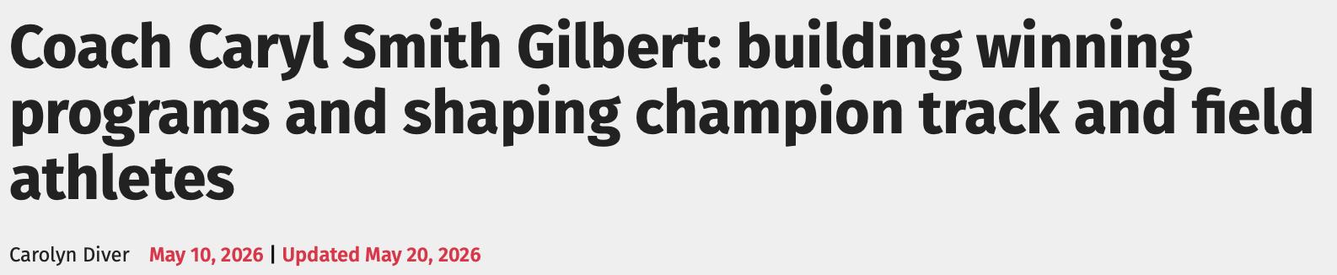
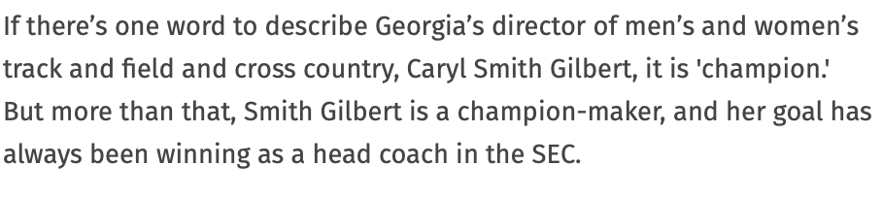
Types of leads
Anecdotal lead

Slide 9
Types of leads
Delayed lead
Good for in-depth stories
Captures the reader’s attention in story-form manner
Should end with a “drop the mic” moment

Slide 10
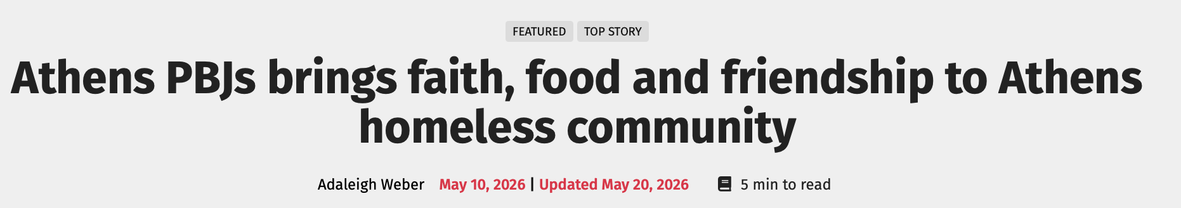
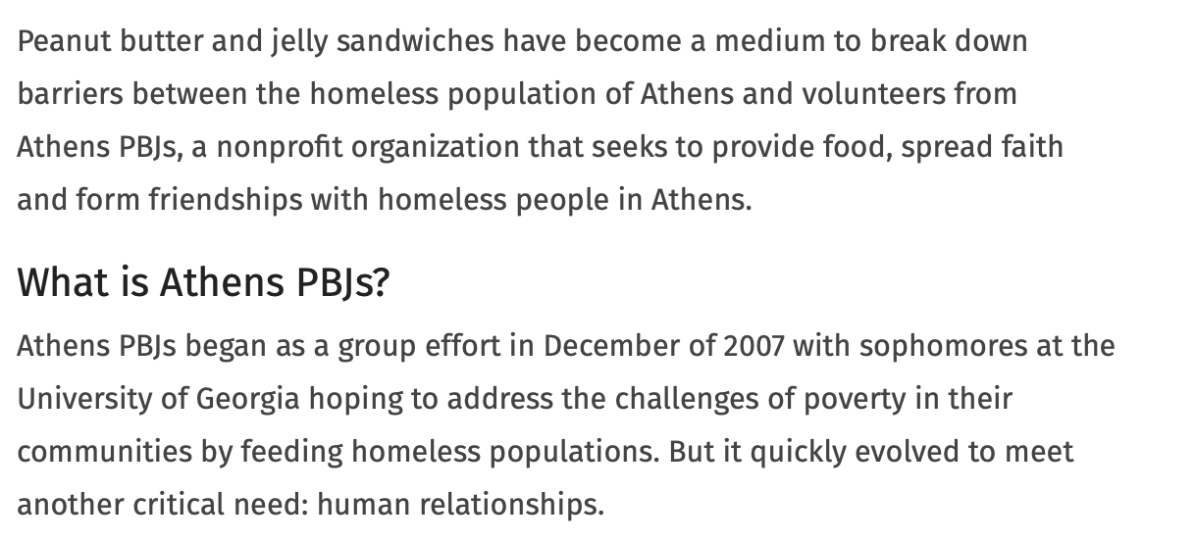
Types of leads
Delayed lead

Slide 11
Types of leads
Contrast lead
Good for ”against the odds” stories
Good for showing something unexpected – catches the reader off guard (even though they know it’s coming)
It should be evident to the writer if a contrast lead will work

Slide 12

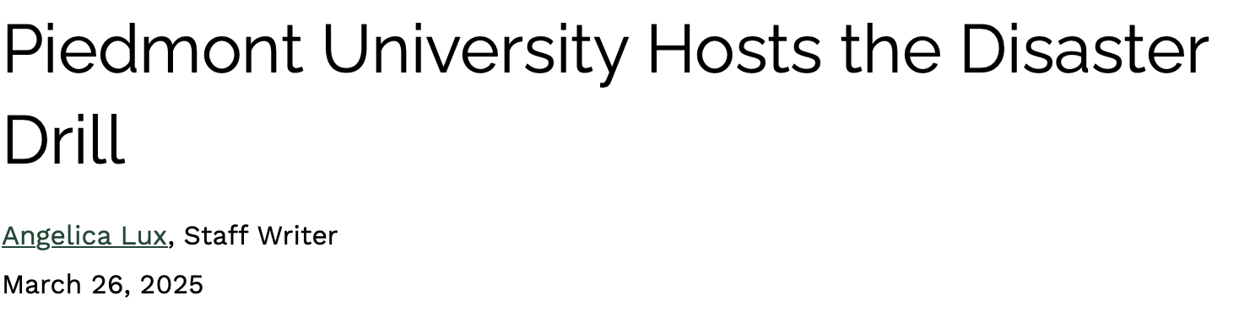
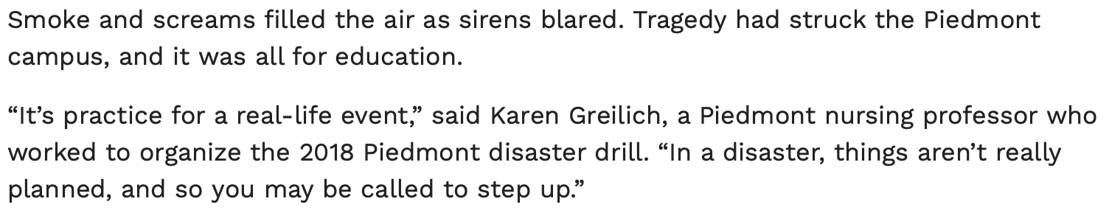
Types of leads
Contrast lead

